Slide 1
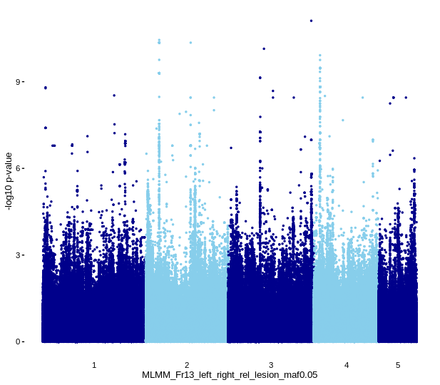
Genome Wide Association Studies (GWAS)
Association of SNPs with phenotype
Gene identification

Slide 2
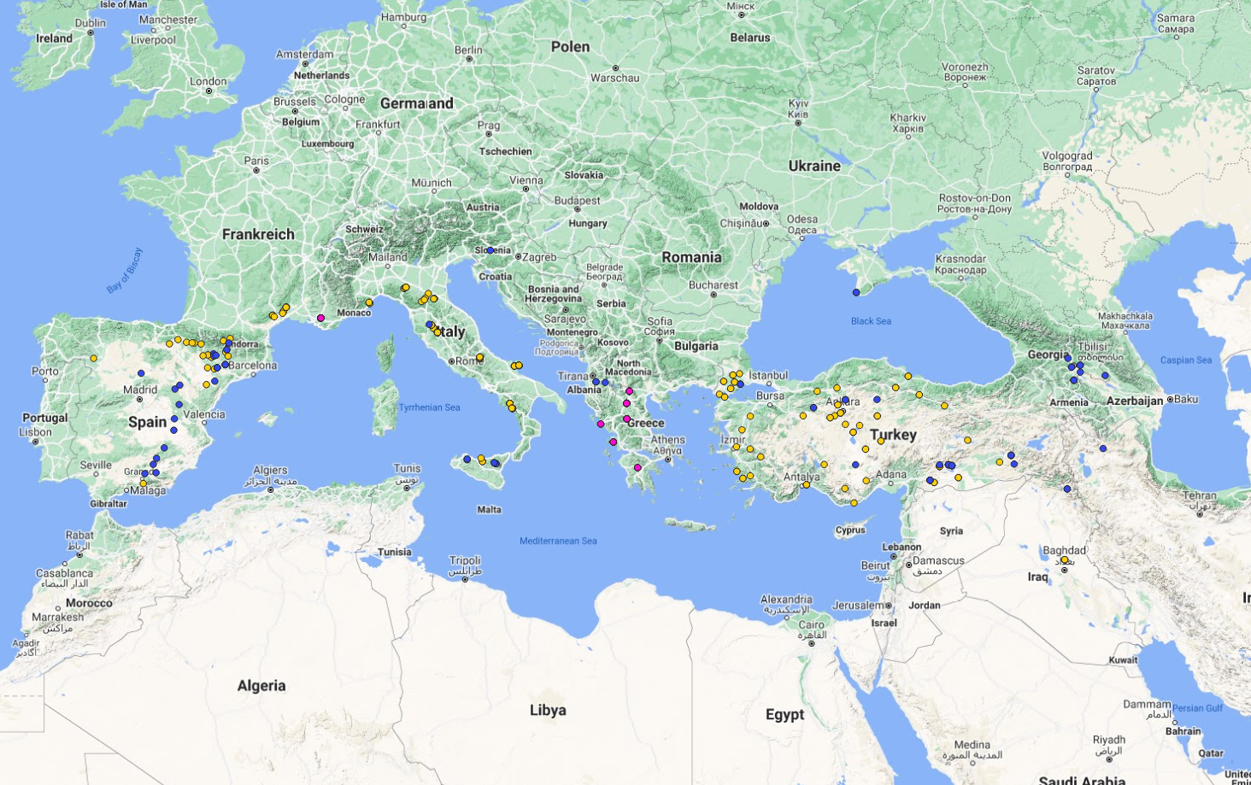

Slide 3
Project I
“GWAS on seed size of Brachypodium distachyon”
110 accessions
10 seeds per accession
Scanning

Slide 4
Project I
“GWAS on seed size of Brachypodium distachyon”
Goals
Manhattan Plot
Choice of threshold
Gene identification

Slide 5
Project II
“Genome-Environment Associations in B. distachyon using bioclimatic variables”
>300 accessions
Existing bioclimatic variables

Slide 6
Project II
“Genome-Environment Associations in B. distachyon using bioclimatic variables”
Goals
Download variables (soil, UV radiation)
Manhattan plots
Gene identification
Population structure
Nikos
nikolaos.minadakis@botinst.uzh.ch

